Slide 1
Error Bars Considered Harmful: Exploring Alternate Encodings for Mean and Error
Michael Correll and Michael Gleicher

Slide 2
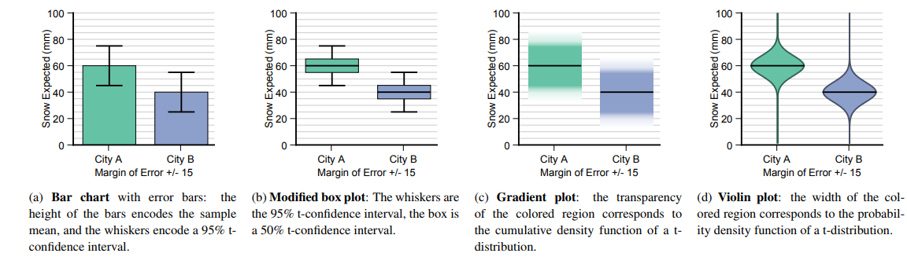
Goal
Investigate the drawbacks with this standard encoding (Bar chart)
Consider a set of alternatives (Modified box plot, gradient plot, violin plot) designed to more effectively communicate the implications of mean and error data to a general audience

Slide 3
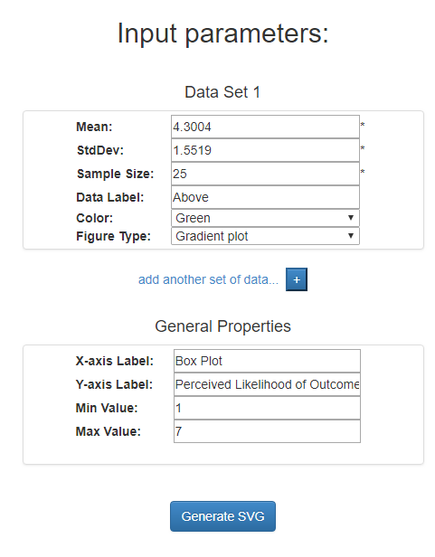
Setup
Chose to replicate one-sample judgements experiment from the three experiments in the paper
Chose one out of the three wordings
Used error bars visualizations provided by the authors
Used Google forms to create the questions
Deployed the survey on Mechanical Turk
Analyzed the responses (Python libraries, Excel)

Slide 4
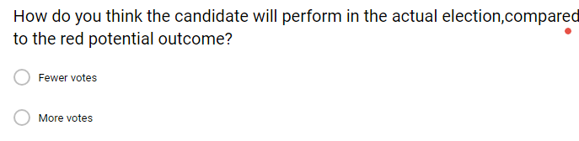
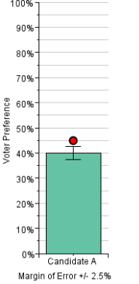
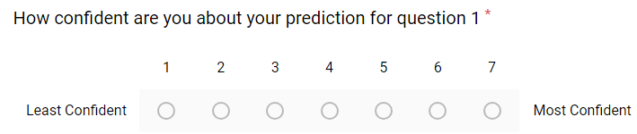
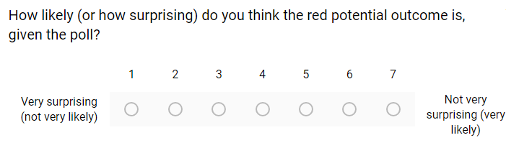
Questions Asked

Slide 5
Hypothesis
Participant responses would generally follow expected behavior - supported
We expect the participant answers (Q1) to follow sample mean (get the answers right)
We expect confidence (Q2) to follow cdf
WE expect likelihood of the proposed outcome (Q3) to follow pdf
Bar chart has within-the-bar bias while others do not - supported
Gradient and violin plots provide more accurate and more confident judgements - supported

Slide 6
Result - H1
 | Overall Accuracy | R² (confidence, cdf) | R² (likelihood, pdf)
Original Study | 87.1% | 0.805 | 0.842
Replication | 45.1% | 0.002 | 0.002
Result from the paper (generally supported)
Result from my survey
(Not supported)

Slide 7
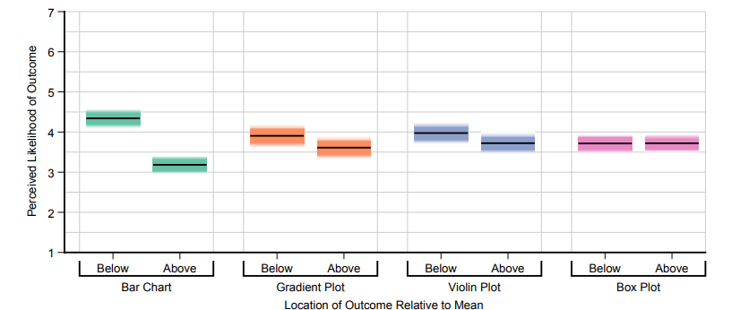
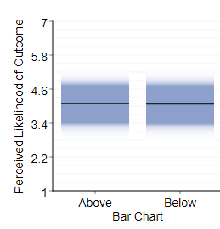
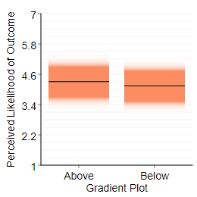
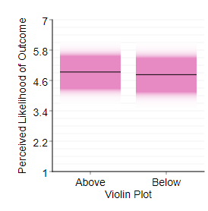
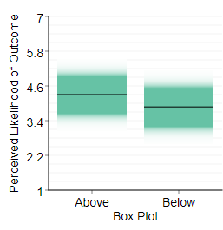
Result - H2
Result from the paper (supported)
Result from my survey
(Not supported)

Slide 8
Result - H3
 | Bar Chart | Box Plot | Gradient Plot | Violin Plot
Accuracy - Original | 83.2% | 87.4% | 88.5% | 89.2%
Accuracy - Replication | 37.8% | 48.1% | 39.7% | 53.5%
Confidence - Original | 4.86 | 4.86 | 5.12 | 5.06
Confidence - Replication | 4.3 | 4.14 | 4.55 | 4.88
Result from original
Generally supported
Result from the replication
Somewhat supported

Slide 9
Discussion
Problems with the analysis
Quality of the participants (No visualization background)
Quality of the answers (Straight line and other patterns)
Number of responses (Budget constraint)

Slide 10
Conclusion and Future Work
The first two hypothesis was definitely not supported
The third hypothesis was somewhat supported
Cannot conclude anything from this experiment
Quality of the dataset

